Slide 1
First Term Success Workshop
Self-Service

Slide 2
Enabling Objectives
DEFINE the purpose of MyNavy Assignment (MNA)
DEFINE the purpose of Career Waypoint (CWAY) Self-Service
Define the purpose of Job Opportunities in the Navy (JOIN)
IDENTIFY the functions of BUPERS Online (BOL)
IDENTIFY the functions of Navy Standard Integrated Personnel System (NSIPS)
IDENTIFY the functions of MyNavy Portal (MNP)
Notes:
FACILITATOR GUIDE:
Review objectives

Slide 3
References
My Navy Assignment- https://mynavyassignment.navy.mil/mna/Index.action
BUPERS Online- https://www.bol.navy.mil/BAM/
Navy Standard Integrated Personnel System- https://www.nsips.cloud.navy.mil/my.policy
MyNavy Portal-
https://my.navy.mil/index.html
Notes:
FACILITATOR GUIDE:
Review references

Slide 4
MyNavy Assignment (MNA)
Web-based system that allows Sailors to:
  View and apply for available jobs
  Conversions are initiated through MNA unless it requires a package
  View detailing milestones
  Communication with Detailers
  Update resume and preferences
  PACT Sailors have ability to choose rating designation through MNA
Notes:
FACILITATOR GUIDE:
MyNavy Assignment (MNA) is designed and used by Sailors, Command Career Counselors, and command personnel. The Web-based system allows Sailors to view available jobs and make applications. MNA provides Sailors more options, greater career flexibility and increased transparency. MNA supports MyNavy HR goals to transform MNHR, deliver Sailor 2025, and man the fleet to support a 21st Century fighting force.
AC/TAR Sailors applying for Reenlistment and Conversion apply in My Navy Assignments during their PRD window.

Slide 5
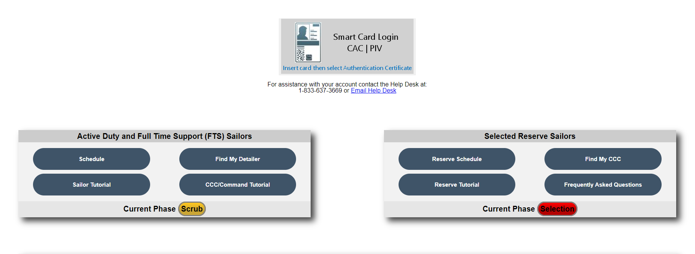
MyNavy Assignment (MNA) Homepage
NEGOTIATION SCHEDULE
HOW TO FIND WHEN MNA IS OPEN OR CLOSED.
DETAILER INFO
HOW TO GET DETAILER CONTACT INFORMATION
Notes:
FACILITATOR GUIDE:
Emphasize the tutorial, schedule, detailer contact info, and resources.

Slide 6
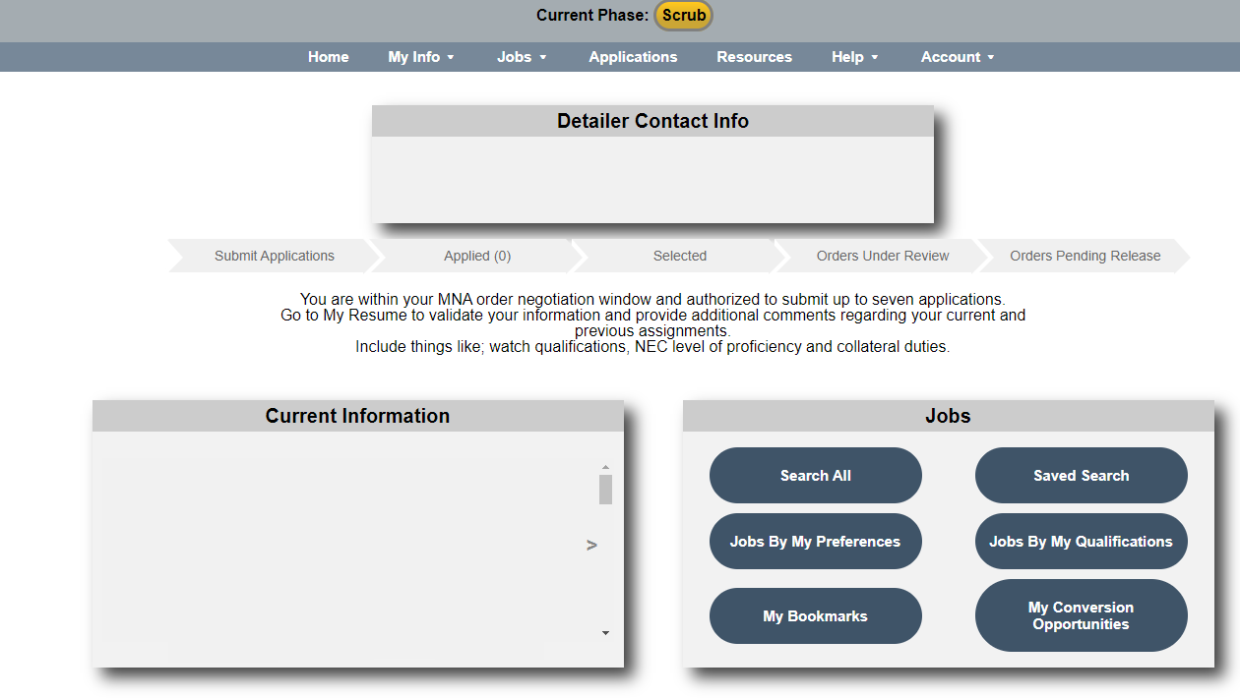
MyNavy Assignment (MNA) Homepage Login
Detailer
notes
JOBS
SEARCH ALL
AVAILABLE JOBS
Notes:
FACILITATOR GUIDE:
Displays detailer current information, additional notes from detailer, Sailors information, application history, and recourses
ADDITIONAL NOTES:
The Sailor Conversion Opportunities Page (SCOP) is gateway to MNA’s added conversion functionality. Job conversion opportunities are filtered based on Year Group and a Sailor’s personal information.
My Resume provides a snapshot of service record to highlight professional skills, personal details and experience.
The Sailor Resume page details information such as: Assignment History, NECs, Warfare, Professional Information, Education and Language Performance Data, Physical Fitness, Family Information, and Resume Comments.

Slide 7
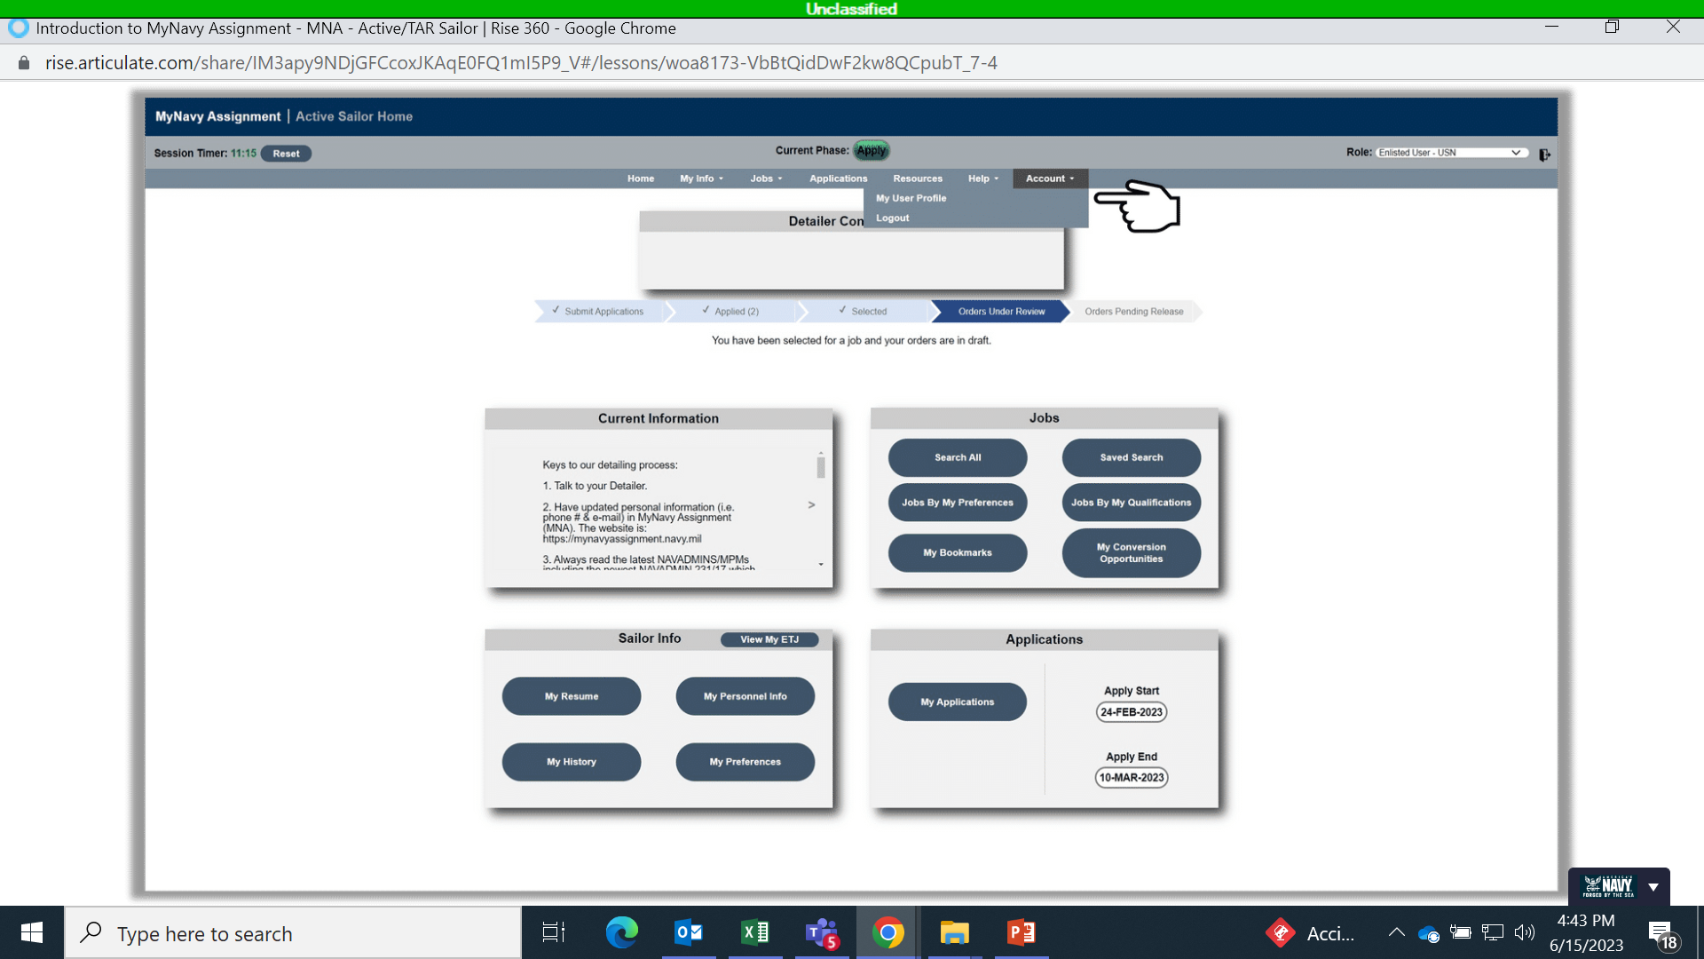
MyNavy Assignment (MNA) Sailor Info
My User Profile
Set communication preferences and update phone number, and email address
My Personnel Info
View your personal details and verify service record information that is reviewed by Command personnel and Detailers
My Resume
Use to market yourself by annotating qualifications and work experience, etc.
My Preferences
Update job preferences, career intentions and interests
My History
Snapshot of school and platform history, PRIMS data, Eval/FitRep data, and warfare designations.
Notes:
FACILITATOR GUIDE:
Provides access to personnel searches and individual personnel data including My Sailor Info, My Career History, My Alert History, My Preferences, and My Resume.
**Explain the fields annotated.

Slide 8
Career Waypoint (C-WAY)
Used to match qualification data of Sailors to Fleet requirements
4 Functions:
  Qualifying and adjudicating civilians into the Navy as enlisted Sailors
  Controlling rating entry standards
  Providing qualifications for MNA to fill billets/convert rate
  Allow Sailors to obligate service
Component changes
RC lateral rate conversions
PACT Marketplace
Notes:
FACILITATOR GUIDE:
-Component changes include: (Active Component (AC)/Training and Administration of Reserve (TAR)/Selected Reserves)
AC/TAR to SELRES; SELRES to AC/TAR
-SELRES applications are made via CWAY, with auto-created applications for those with remaining MSO for 4+2+2 sailors.
-PACT Marketplace- used to track PACT intentions and designation progress
Statuses:
• Requires Action - The record must be reviewed and updated with the Member’s desire/eligibility.
• Ready for CCC - DCC has entered the Member’s desire, and it is ready for CCC review and submission.
• Requests Participation - Member has requested to participate in PACT Marketplace.
• Requests Onboard - Member can request to remain onboard current command.
• Declines Participation - Member declined to participate in MNA PACT Marketplace.
• Not Eligible - Member is not eligible, for example, Legal/Moral disqualification, performance, etc.
• Transmitted to MNA - Member’s record sent to MNA with all Member’s qualified jobs.
• Approved - Member was approved for a rate and order via the MNA PACT Marketplace.
• Approved-Revoked - Previous approved rate and orders returned and/or revoked.
• Denied - Member’s request was denied during the cycle.
• Think of C-WAY quota as a “ticket” needed to get on the reenlistment “ride”- number of “ticket holders” is used to project rate manning health (C-WAY system ensures "ticket holders" are eligible and willing to continue service)

Slide 9
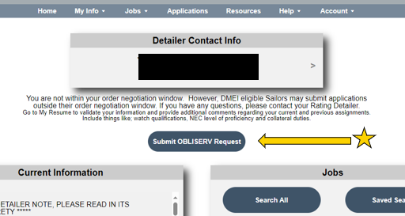
Career Waypoint (C-WAY)
Sailors request CWAY quota via MyNavy Assignment (MNA), utilizing “Submit OBLISERV Request” or via job application
CCC can also manually submit Sailor’s MNA OBLISERV intentions
Notes:
FACILITATOR GUIDE:
MNA will provide two ways for the Sailor to request OBLISERV authorization to extend or reenlist, either through a Job Application triggered request or a manually submitted request, independent of a job application.
The job application triggered request is automatic and does not require a separate submission from the application.

Slide 10
C-WAY Self-Service
Accessed via BOL
My Opportunities
  View qualified jobs
  Reenlistment Opportunities
  PACT designation
My Application
  View submitted applications
My Interests
  View JOIN Assessments
Notes:
FACILITATOR GUIDE:
Please state the purpose of CWAY Self-service and where Sailors can find it?
ANSWER:
Corporate Information Technology system which provides a mechanism for matching personnel inventory to requirements with the best performing Sailors/BOL.

Slide 11
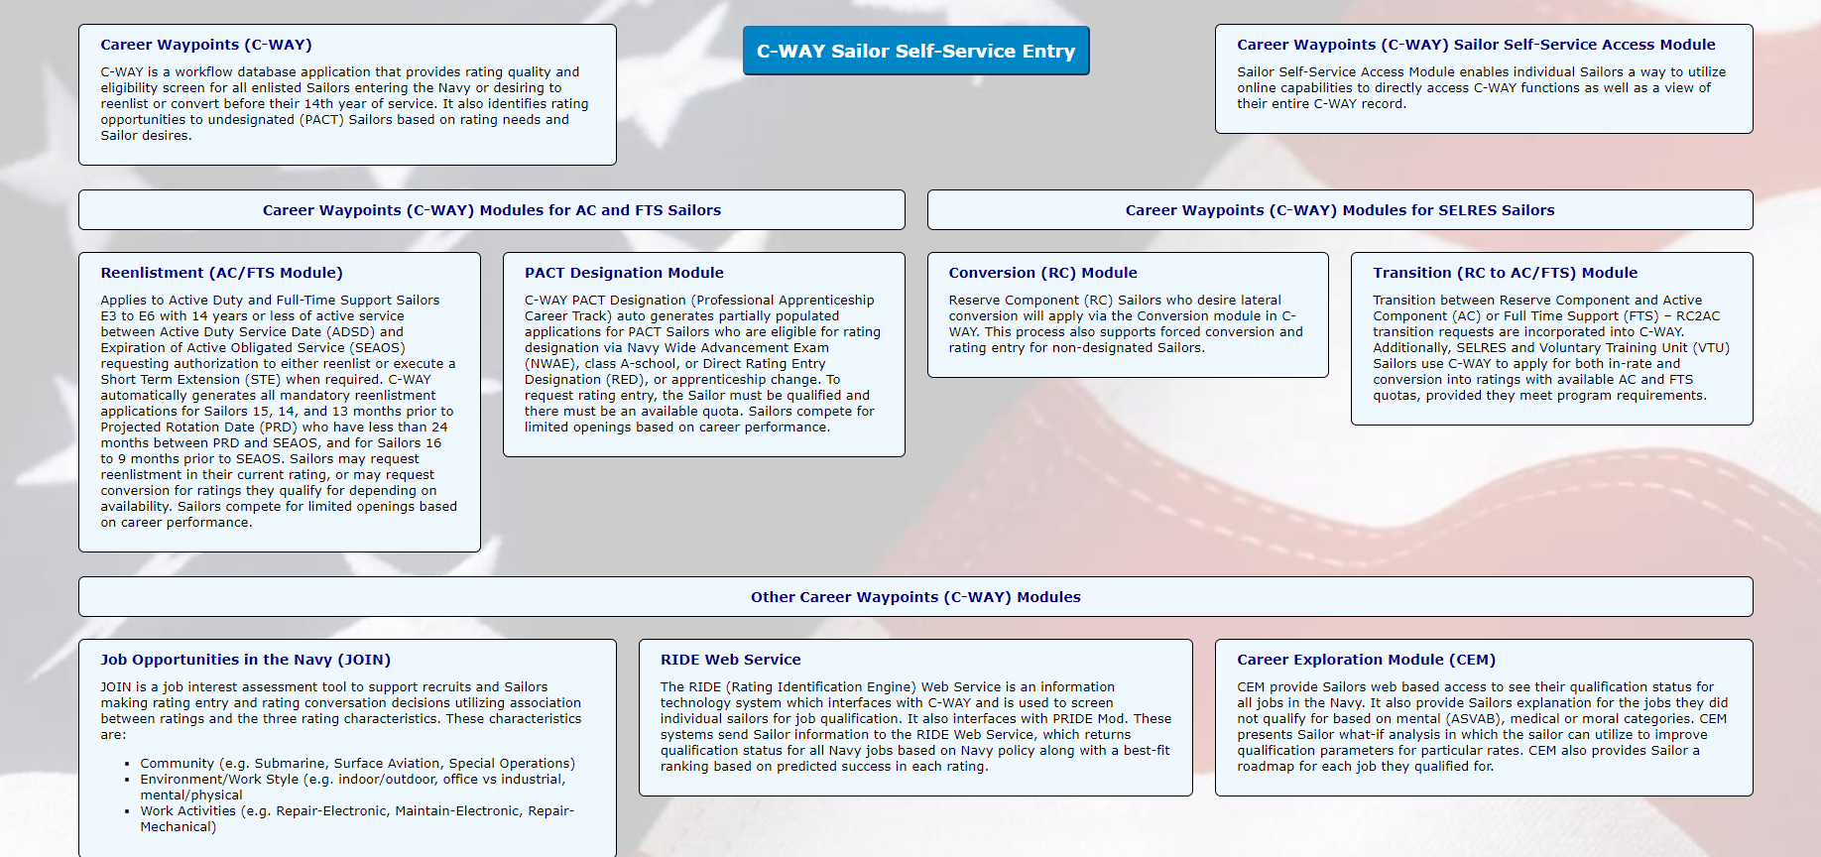
C-WAY Self-Service
Notes:
FACILITATOR GUIDE:
The Sailor Self-Service Access enables individual Sailors with an internet connection and a common access card (CAC) to directly access C-WAY functions, as well as view their entire C-WAY record.

Slide 12
Job Opportunities in the Navy (JOIN)
Job interest assessment tool that supports recruits and Sailors making rating entry and rating conversation decisions.
Leverages an association between ratings and the three rating characteristics to match the Sailors aptitude and interest to make rating recommendations.
  Community (e.g., Submarine, Surface Aviation)
  Environment/Work Style (e.g., indoor/outdoor)
  Work Activities (e.g., Repair-Electronic, Maintain-Electronic)
Notes:
FACILITATOR GUIDE:
Applies to all Sailors matching Sailors interests with their aptitudes.

Slide 13
BUPERS Online (BOL)
A single point of entry application for logging
into numerous web-based applications.
  CWAY/CWAY Self-Service
  Official Military Personnel File (OMPF)
  Personnel Summary Records (PSR I, II, III)
  Individual Medical Readiness (IMR) status
  Navy Personnel Command Document Services
    Name Change
    Letter to the Selection Board
    Award locator
Notes:
FACILITATOR GUIDE:
None

Slide 14
Navy Standard Integrated Personnel System (NSIPS)
Record of Emergency Data/Dependency Application (RED/DA) updates
Electronic Service Record (ESR)
  Member Data Summary
  Orders
  History of Assignments
  Honors and Awards
  Training, Education, and Qualifications
E-Leave
Notes:
FACILITATOR GUIDE:
None

Slide 15
MyNavy Portal (MNP)
Single point of entry for Sailors to manage their careers.
  MyNavy Career Center
  eLeave
  MyPCS (Permanent Change of Station) Checklist
  Electronic Personnel Action Request (ePAR/1306)
  Physical Readiness
  Career & Life Event Content
Notes:
FACILITATOR GUIDE:
None

Slide 16
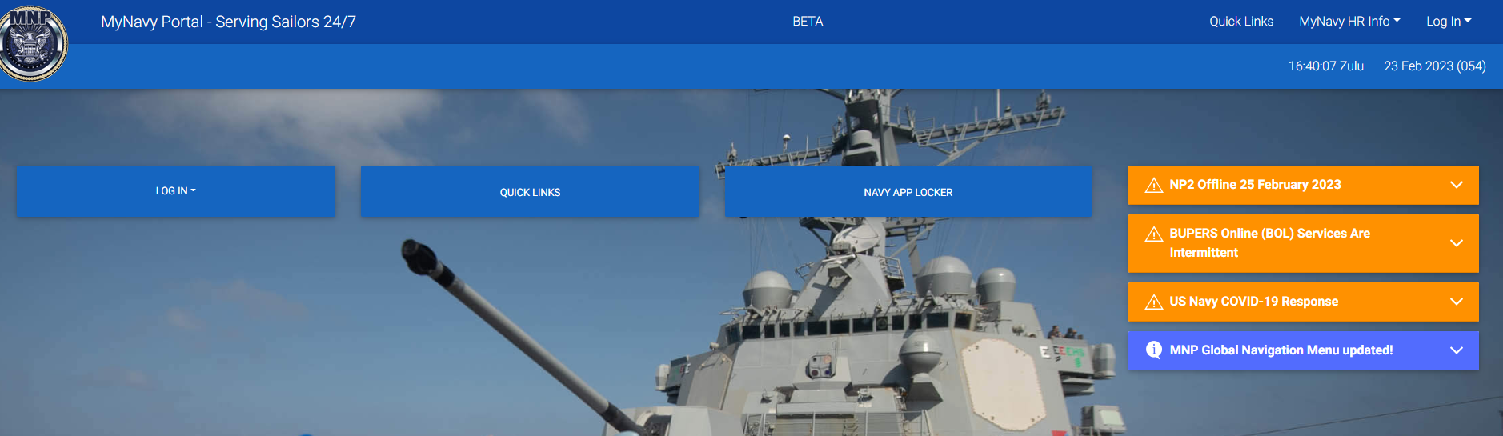
MyNavy Portal (MNP) Homepage
Notes:
FACILITATOR GUIDE:
None

Slide 17
Review and Summary
MyNavy Assignment (MNA)
Career Waypoints (CWAY)
Job Opportunities in the Navy (JOIN)
BUPERS Online (BOL)
Navy Standard Integrated Personnel System (NSIPS)
MyNavy Portal (MNP)
Questions?
Notes:
FACILITATOR GUIDE:
Questions to ask the class:
Who is affected by CWAY?
ANSWER: Paygrades E3-E6, with 14 years or less of active service between their active-duty service date (ADSD) and their current expiration of active obligated service (SEAOS) require CWAY quotas for retention; PACT Sailors; and component changes (AC2RC, RC2AC)
2. What is the purpose of the JOIN survey?
ANSWER: Job interest assessment tool that supports recruits and Sailors making rating entry and rating conversation decisions.
3. What are some of the items you can view in BOL?
ANSWER: CWAY/CWAY Self-Service, Official Military Personnel File (OMPF), Personnel Summary Records (PSR I, II, III), eNAVFIT, Individual Medical Readiness (IMR) status, Navy Personnel Command Document Services, Name Change, Letter to the Selection Board, and Award locator
4. What is the purpose of MyNavy Assignment?
ANSWER: Web-based system that allows Sailors to view/apply for available jobs, as well as apply for conversion opportunities

